Slide 1
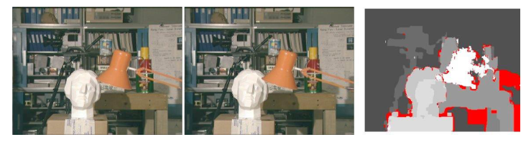
Lab2. Stereo Vision
Max Kovalchuk, MI-4

Slide 2
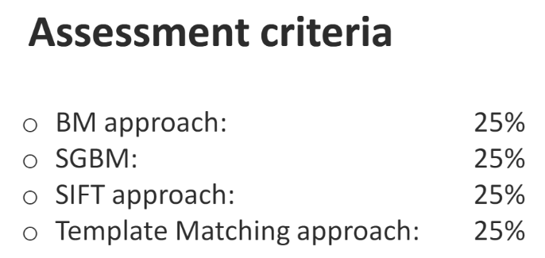
Content
1. Stereo Data
2. Post Stereo Matching Filtering
3. Out-of-box Block Matching
4. In-box Semi Gobal Block Matching
5. Visual Comparison of BM and SGBM
https://github.com/reeWorlds/ML_S4_labs/tree/main/Lab2

Slide 3
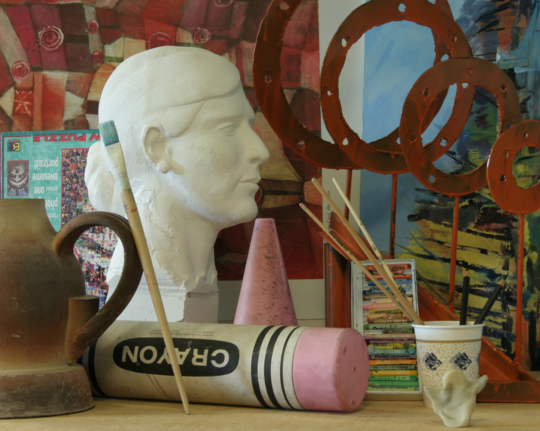
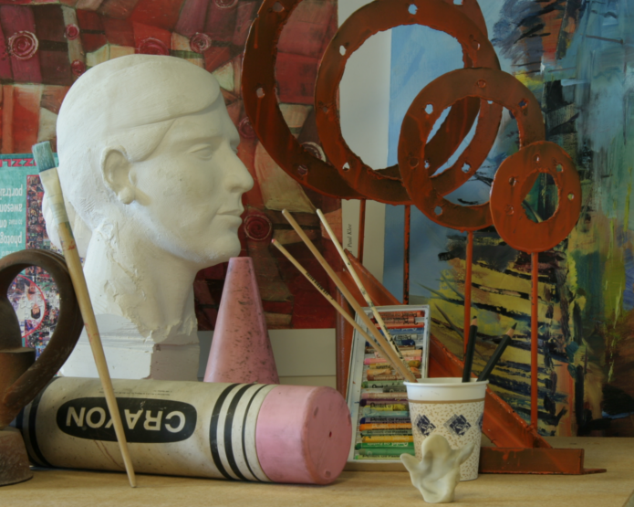
Stereo Data (1)
left
right
695x555
1390x1110

Slide 4
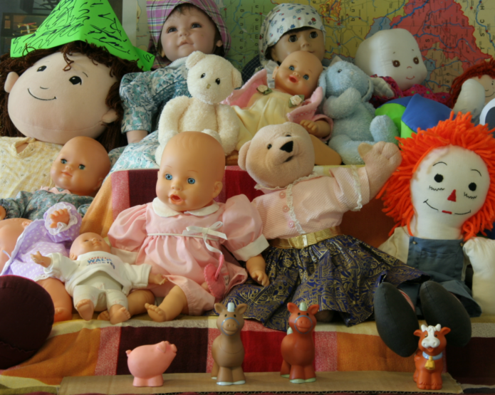
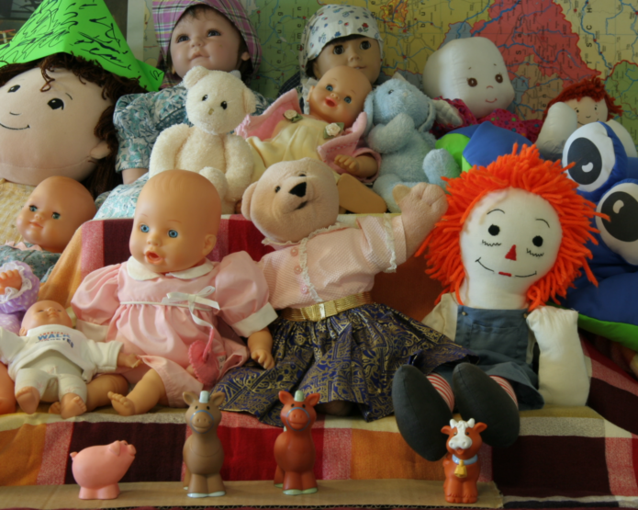
Stereo Data (2)
left
right
695x555
1390x1110

Slide 5
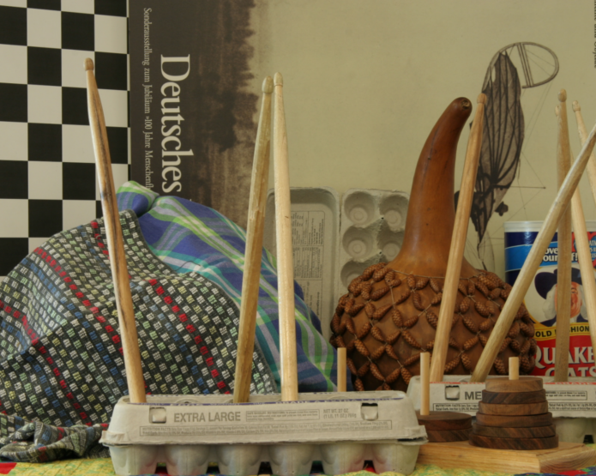
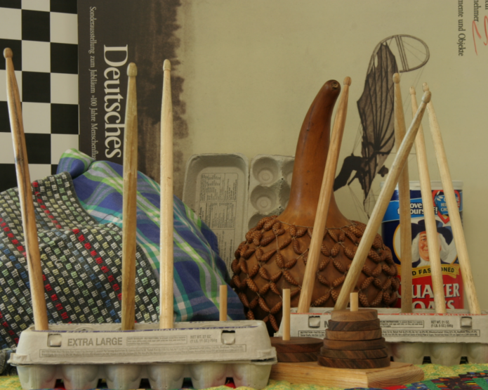
Stereo Data (3)
left
right
695x555
1390x1110

Slide 6
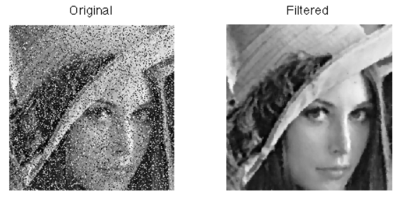
Post Stereo Matching Filtering
Median Filter
Filtering parameter r = BlockSize * 4 + 1

Slide 7
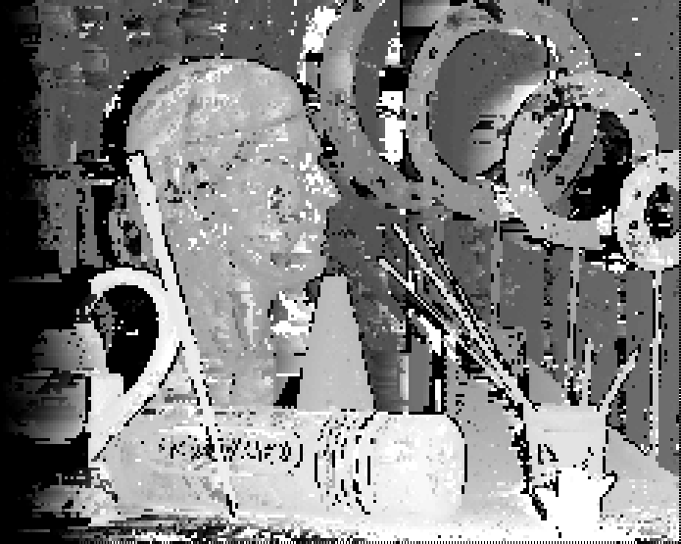
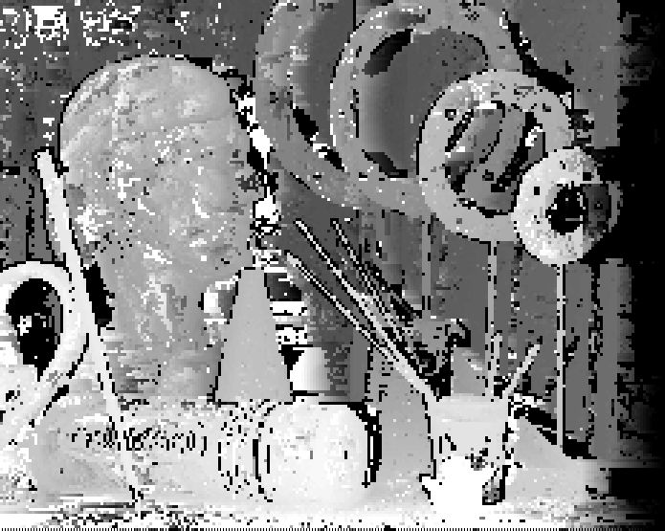
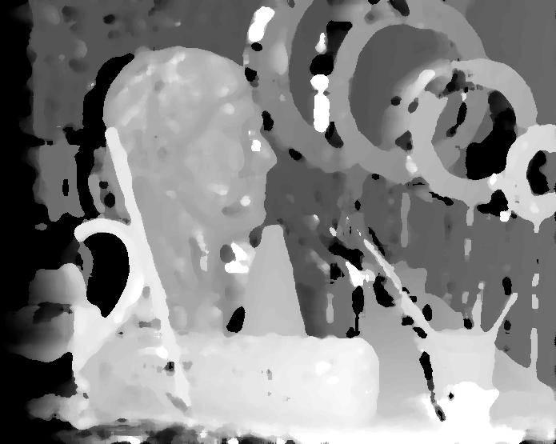
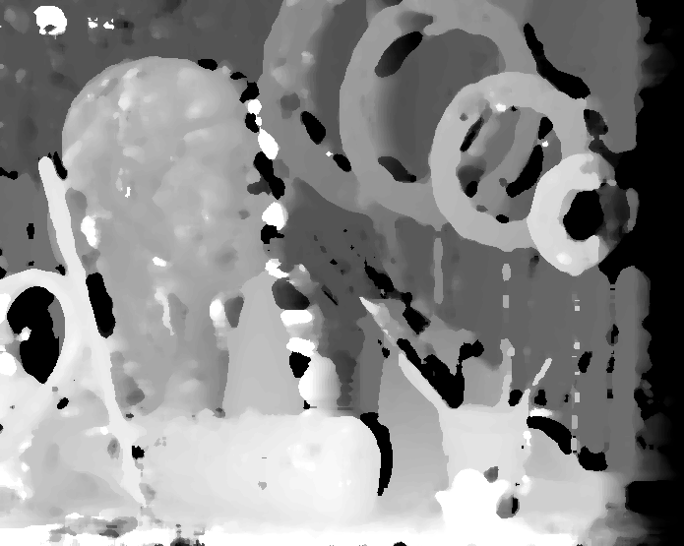
Out-of-box BM (1, medium)
unfiltered
filtered
left
right

Slide 8

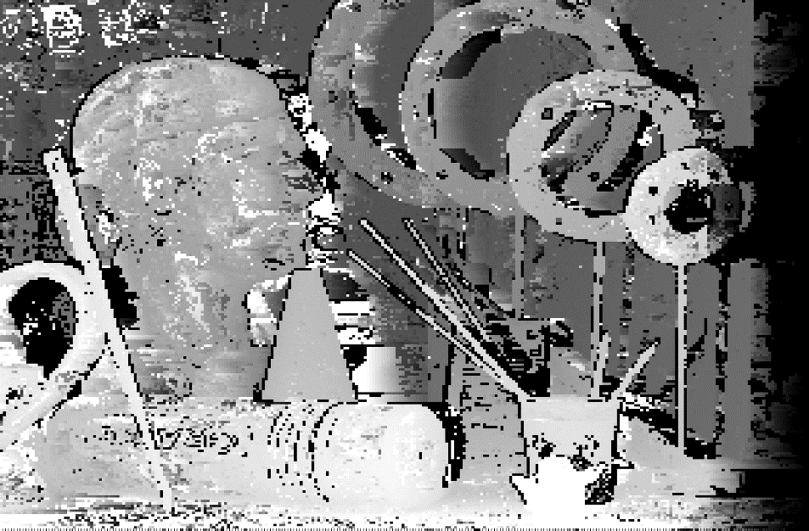
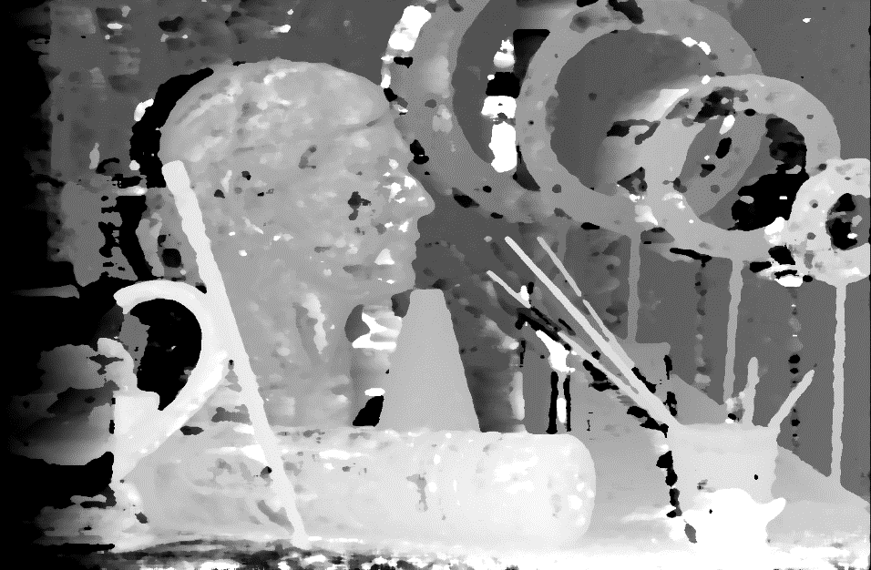
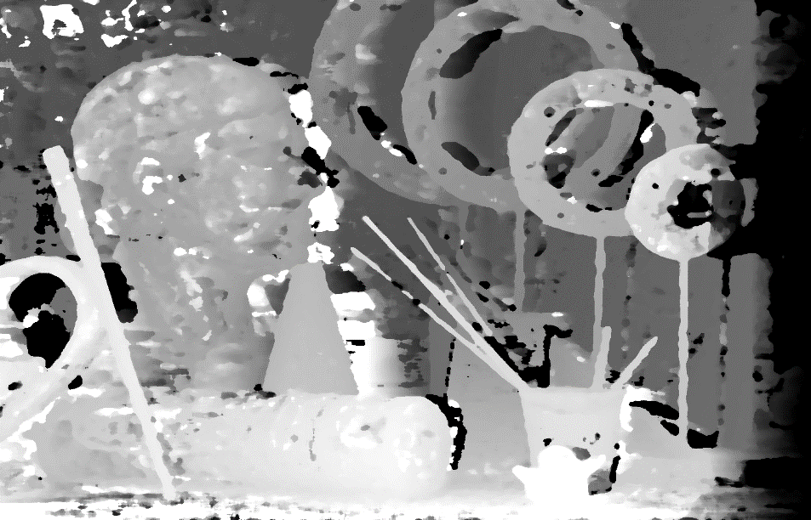
Out-of-box BM (1, large)
unfiltered
filtered
left
right

Slide 9
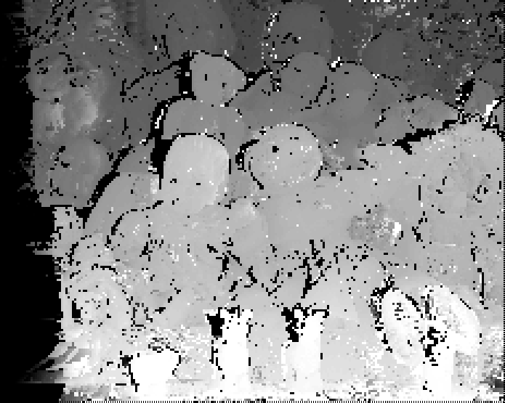
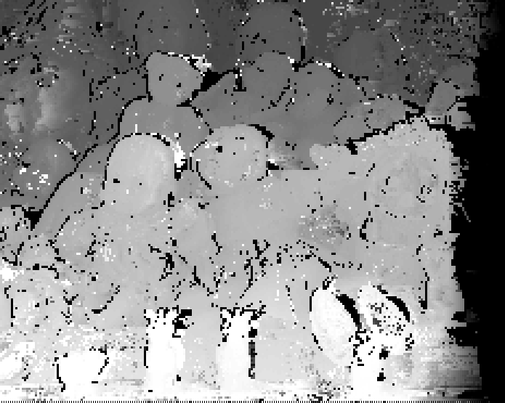
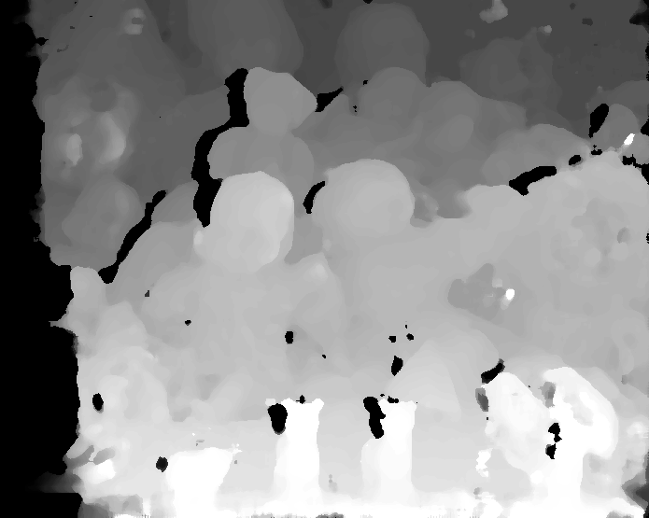
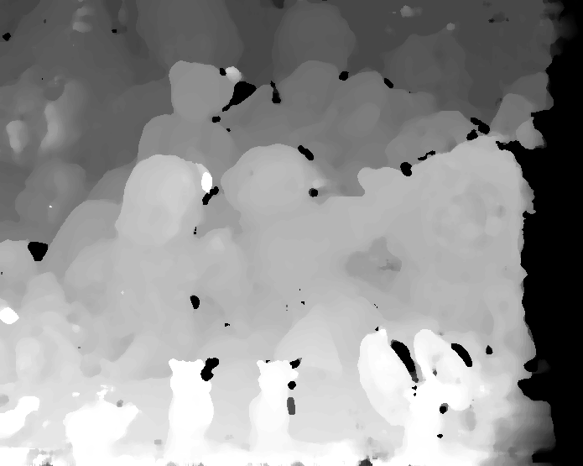
Out-of-box BM (2, medium)
unfiltered
filtered
left
right

Slide 10
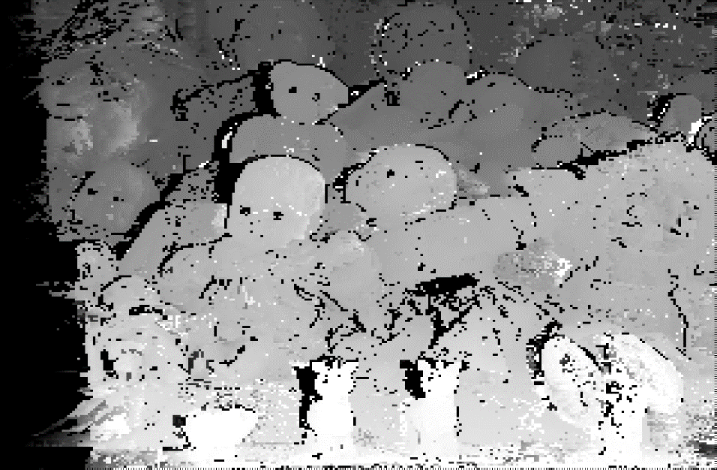
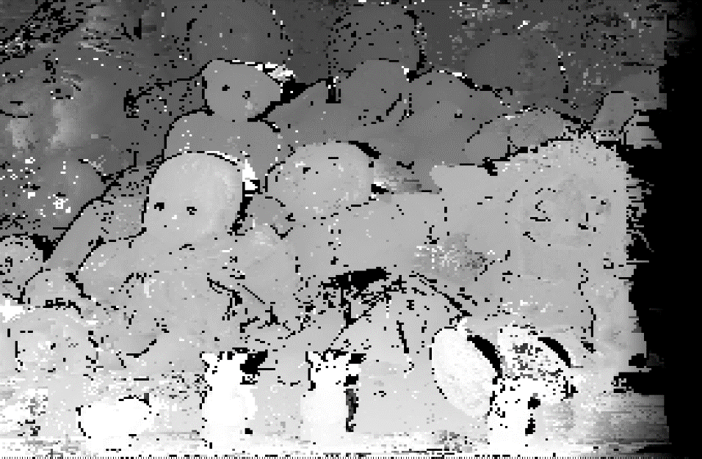
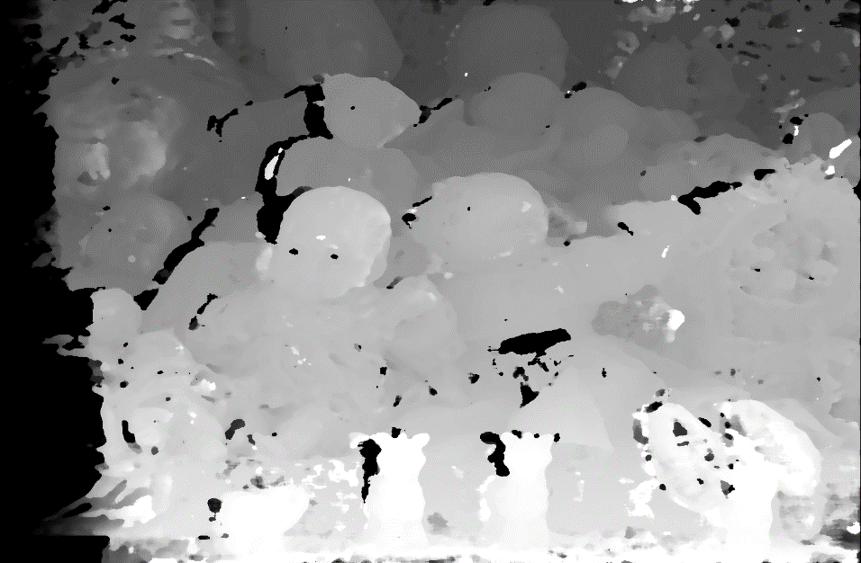
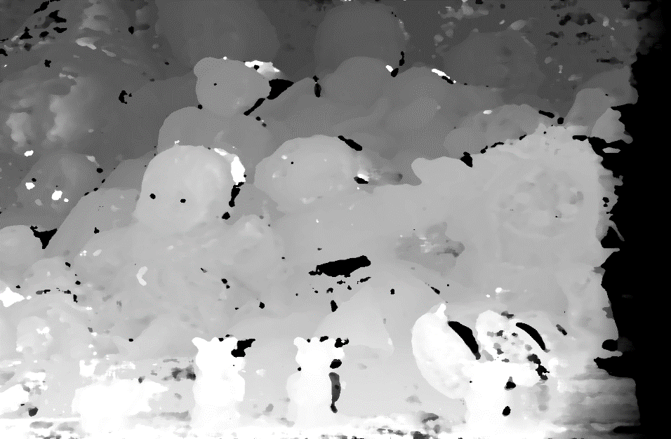
Out-of-box BM (2, large)
unfiltered
filtered
left
right

Slide 11
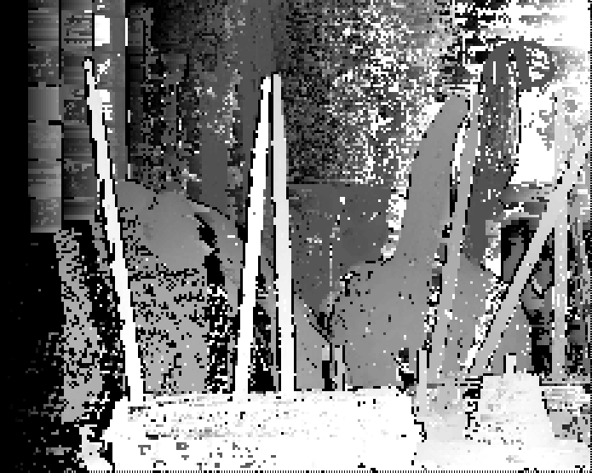
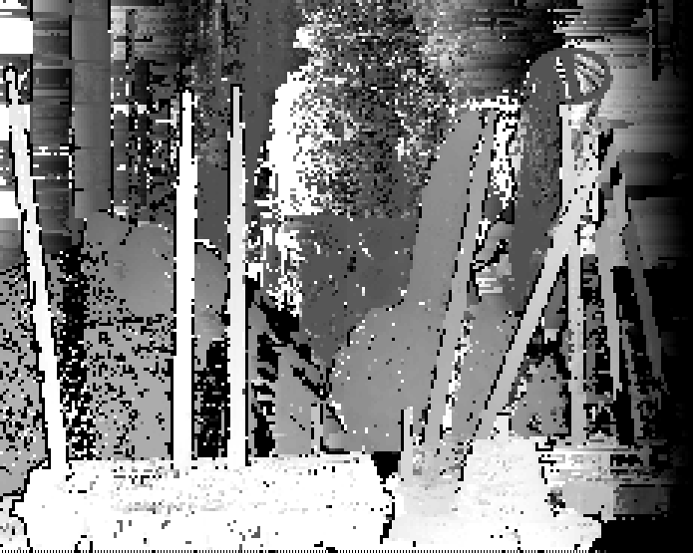
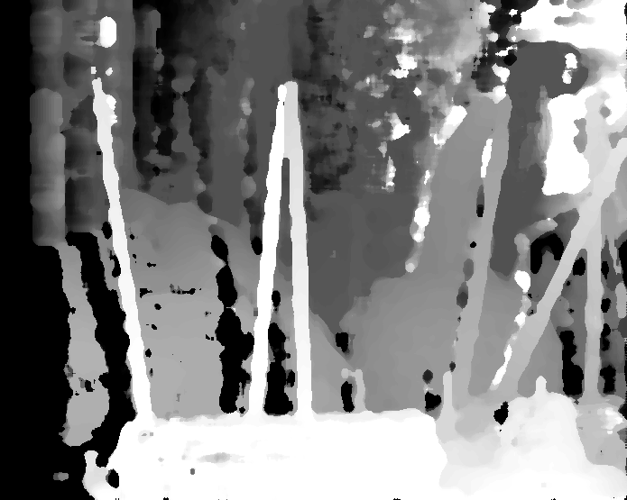
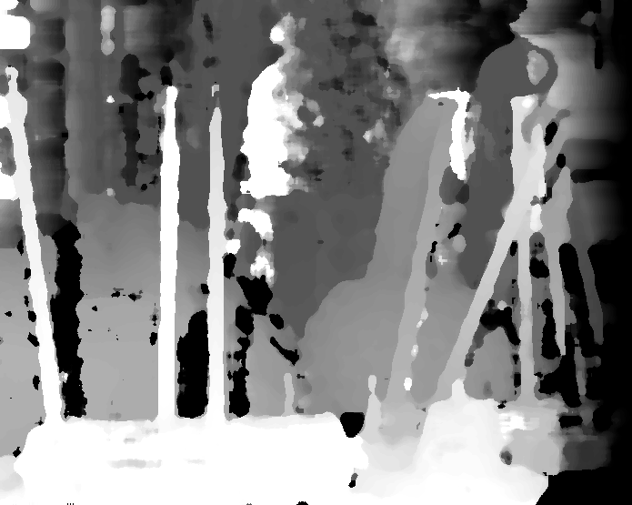
Out-of-box BM (3, medium)
unfiltered
filtered
left
right

Slide 12
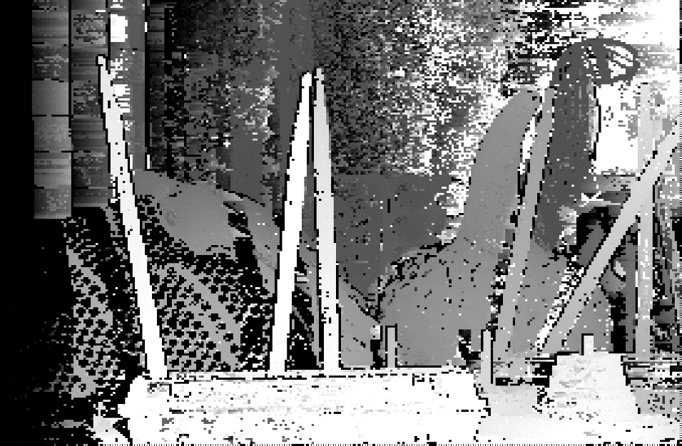
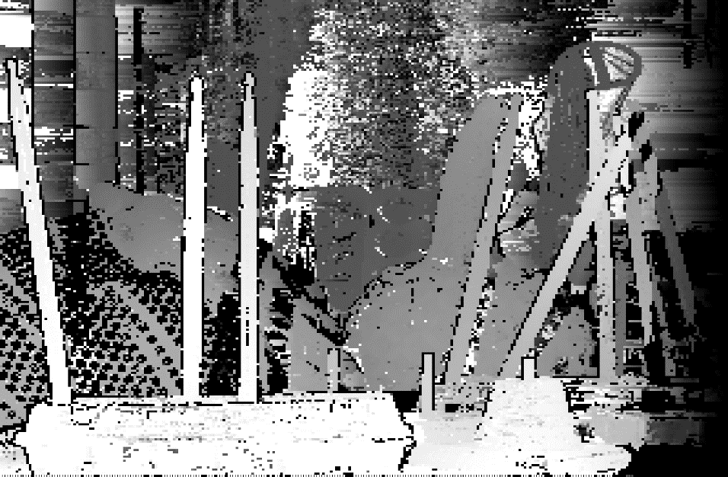
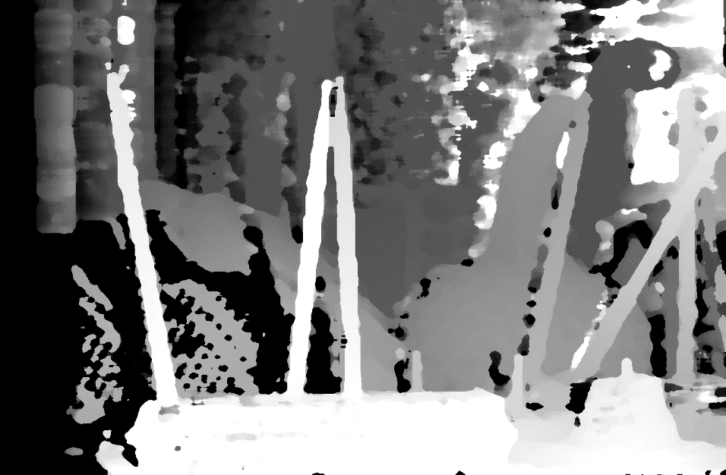
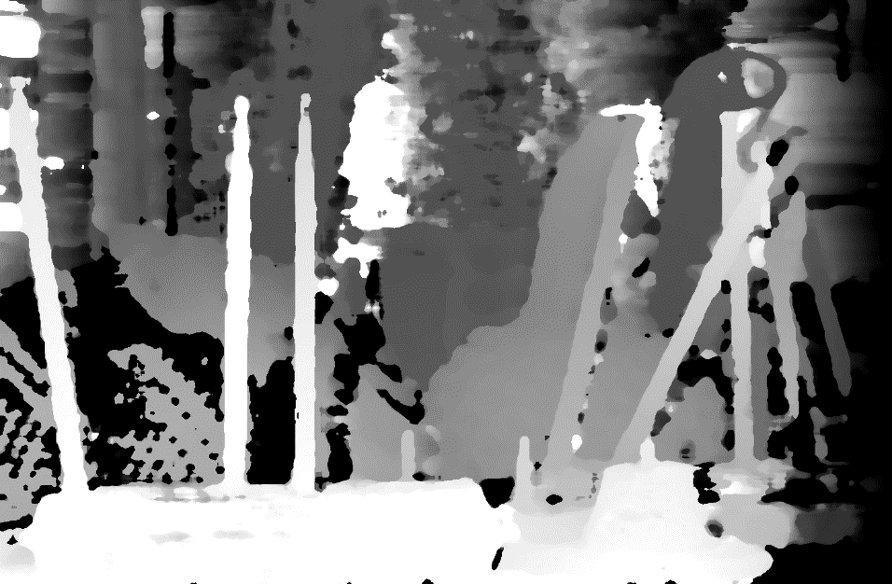
Out-of-box BM (3, large)
unfiltered
filtered
left
right

Slide 13
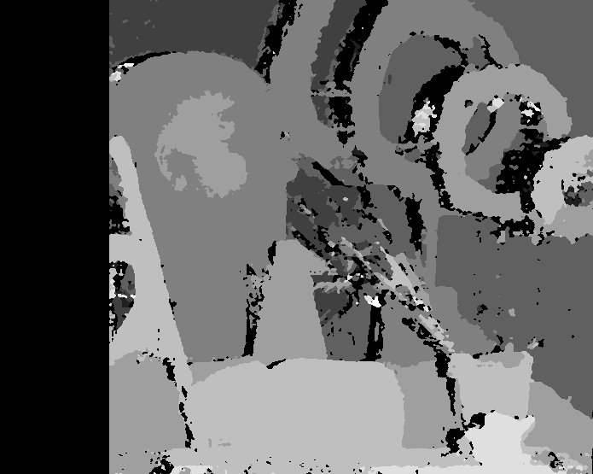
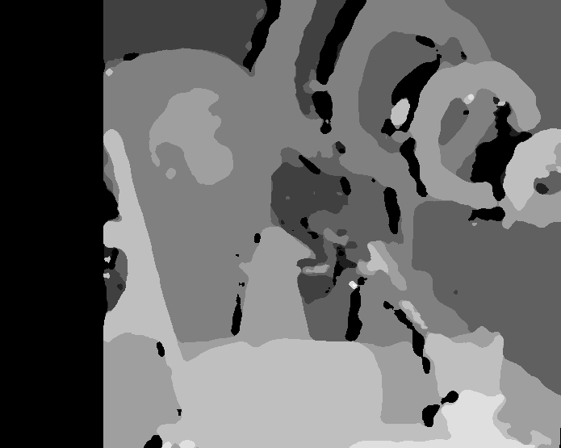
In-box SGBM (1, medium)
unfiltered
filtered

Slide 14
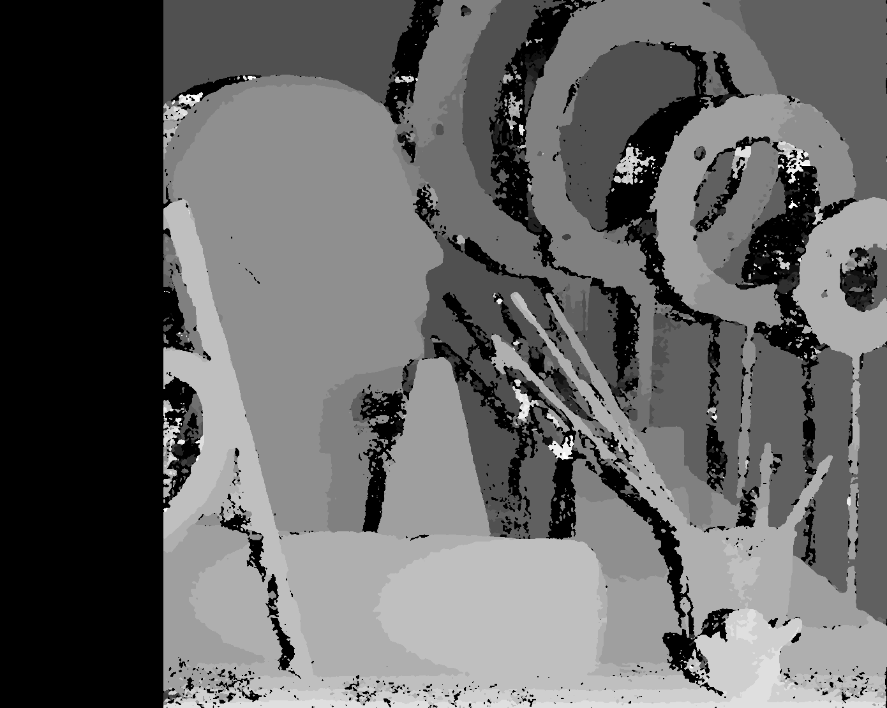
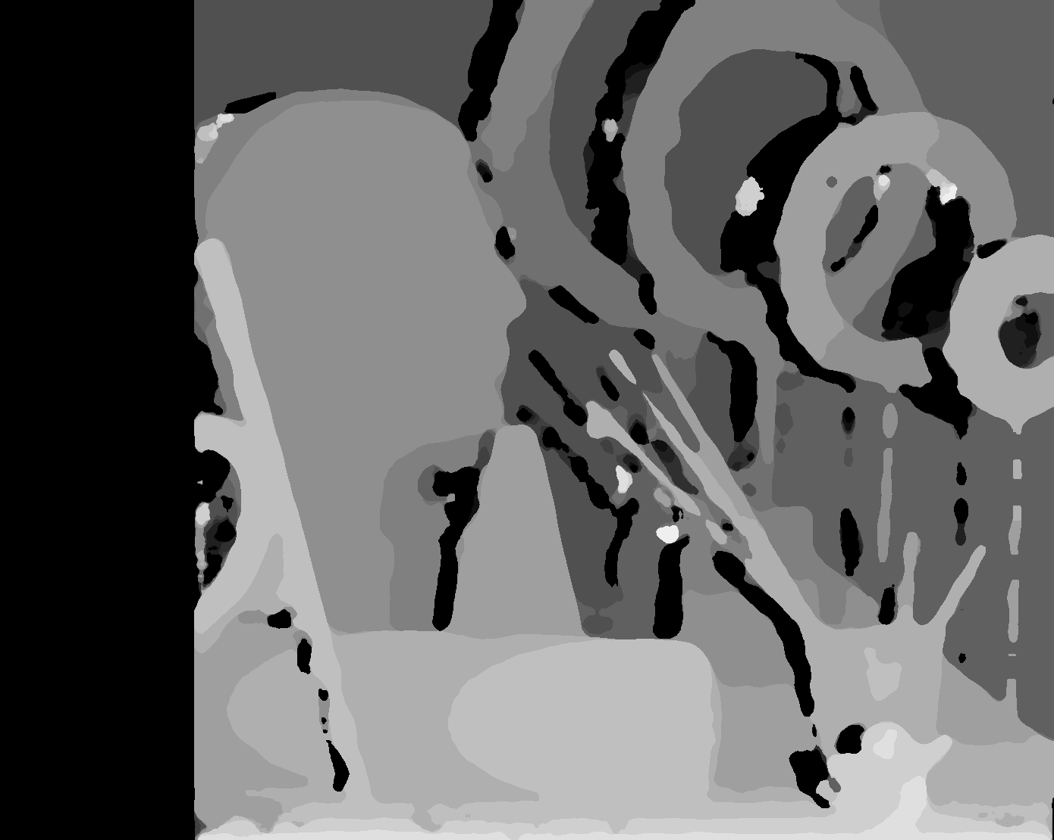
In-box SGBM (1, large)
unfiltered
filtered

Slide 15
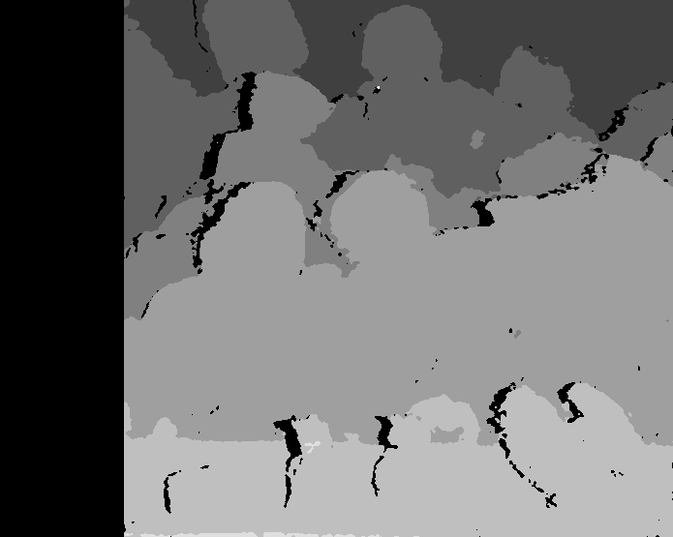

In-box SGBM (2, medium)
unfiltered
filtered

Slide 16
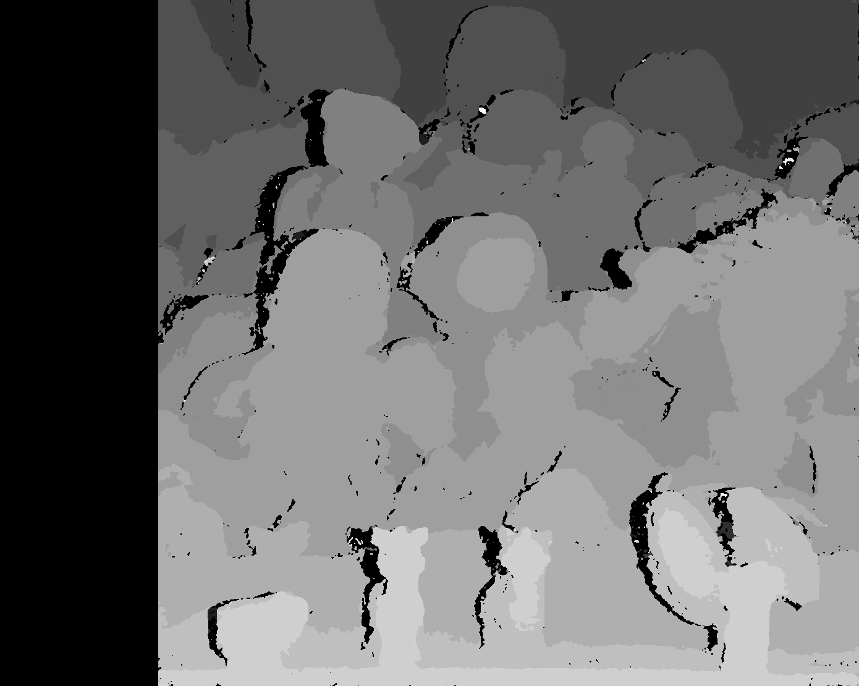
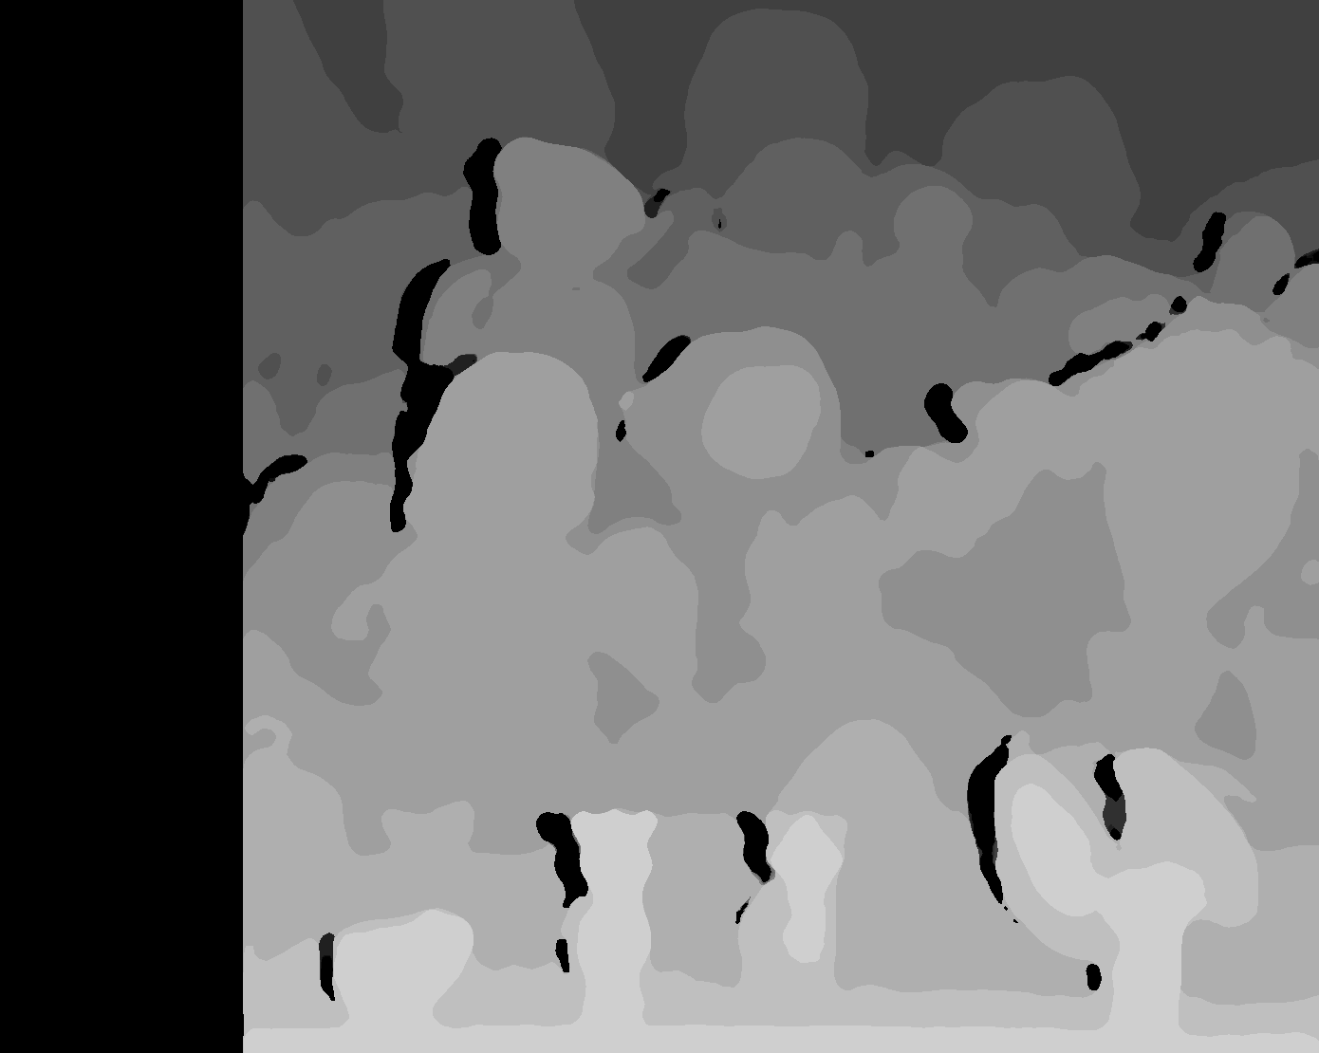
In-box SGBM (2, large)
unfiltered
filtered

Slide 17
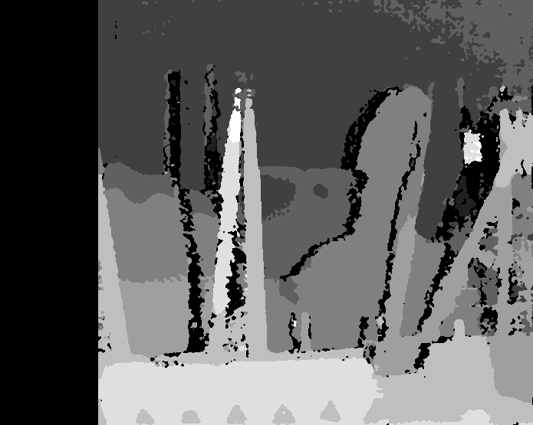
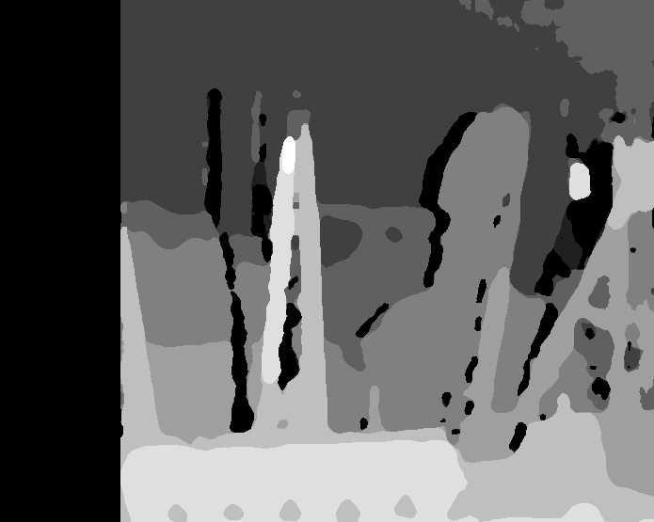
In-box SGBM (3, medium)
unfiltered
filtered

Slide 18
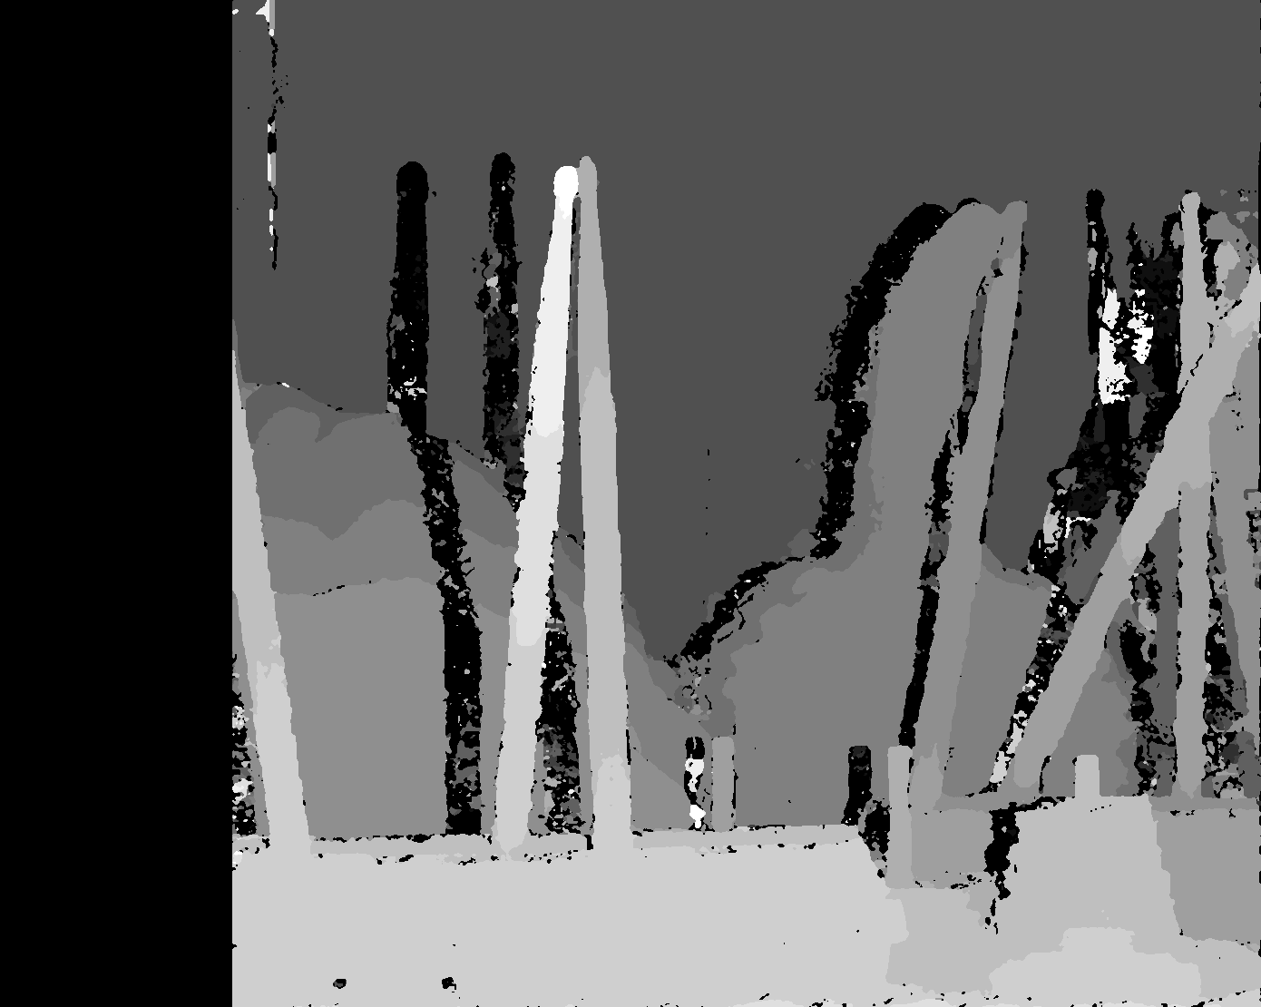
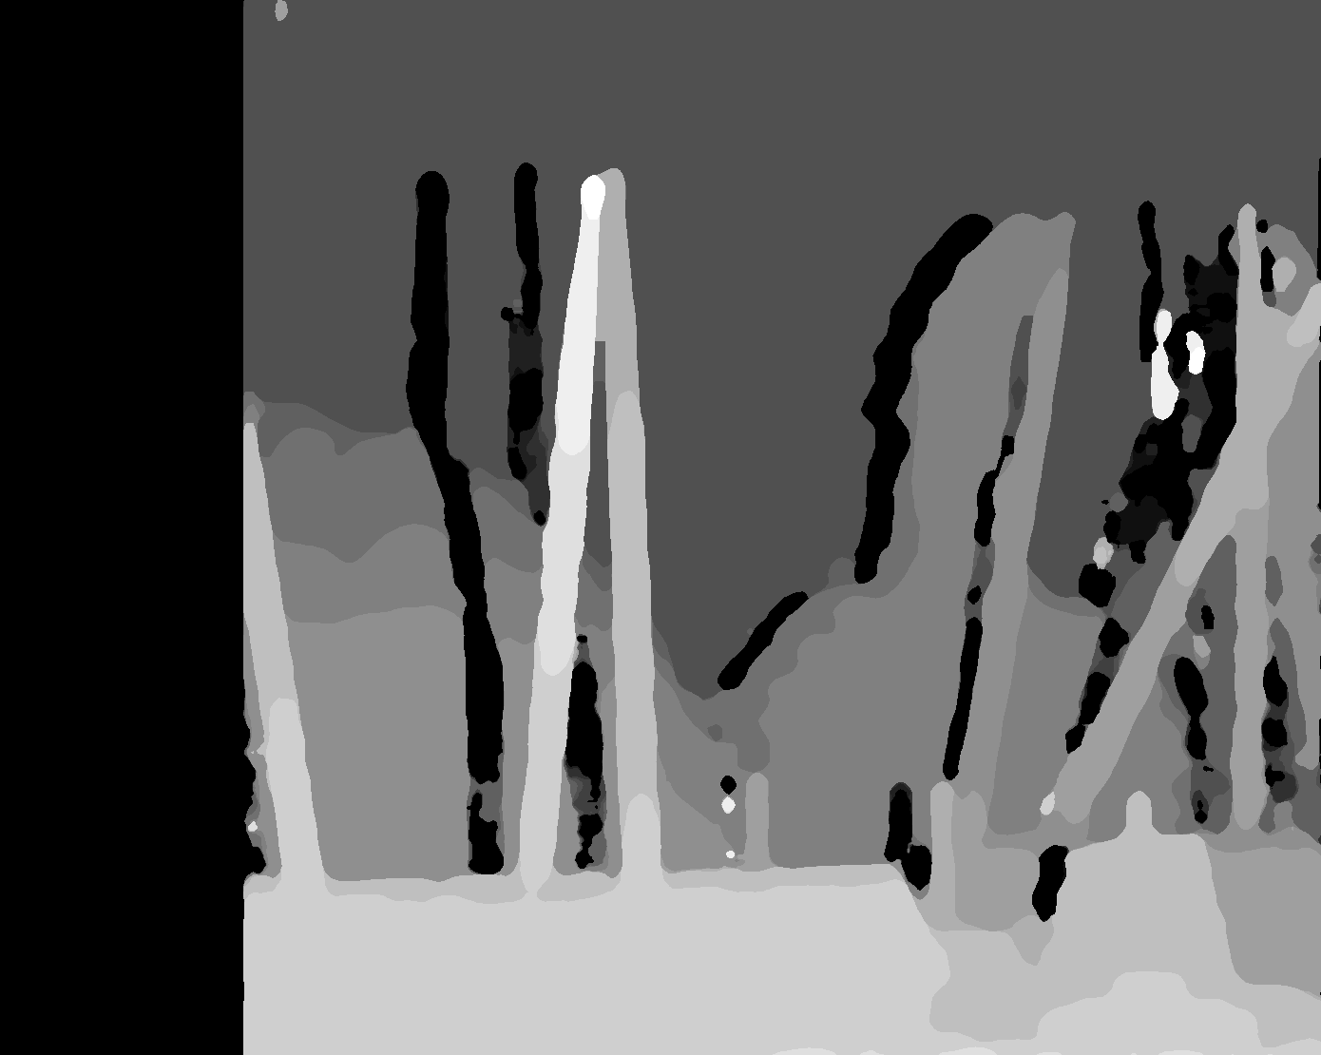
In-box SGBM (3, large)
unfiltered
filtered

Slide 19

BM vs SGBM (1)
Original
BM
SGBM

Slide 20

BM vs SGBM (2)
Original
BM
SGBM

Slide 21
BM vs SGBM (3)
Original
BM
SGBM

